Slide 1

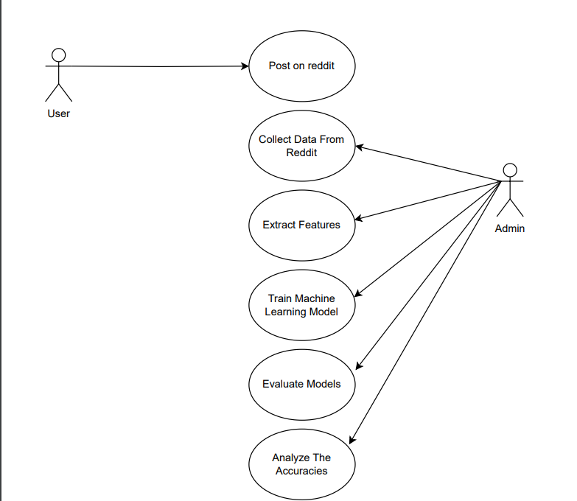
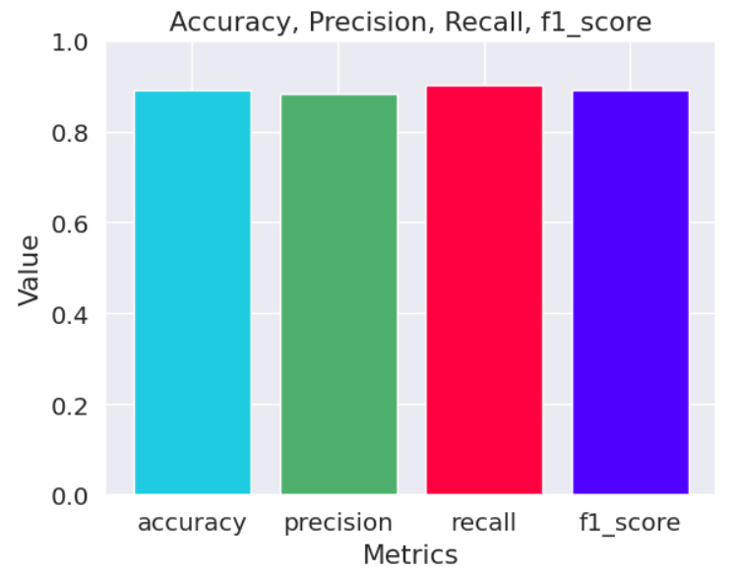
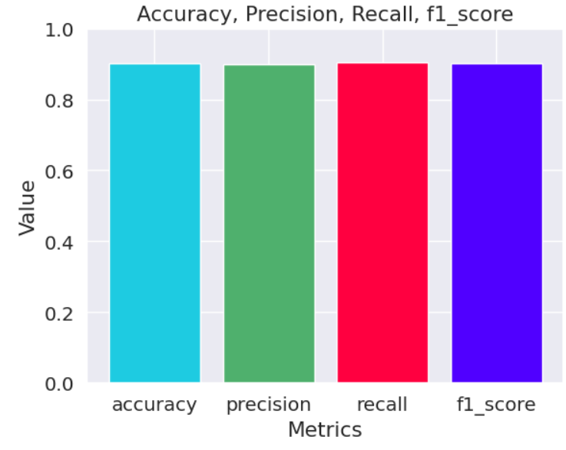
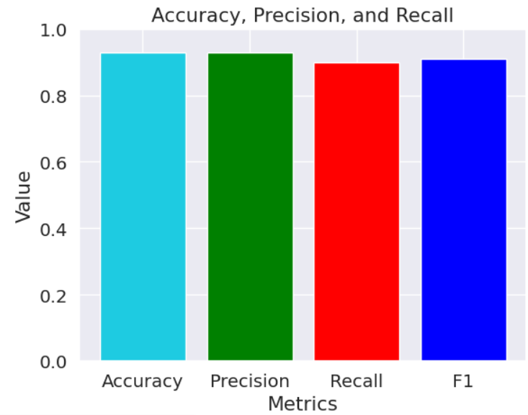
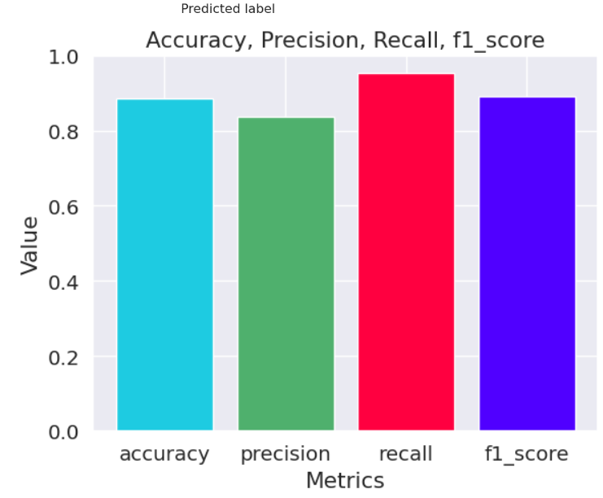
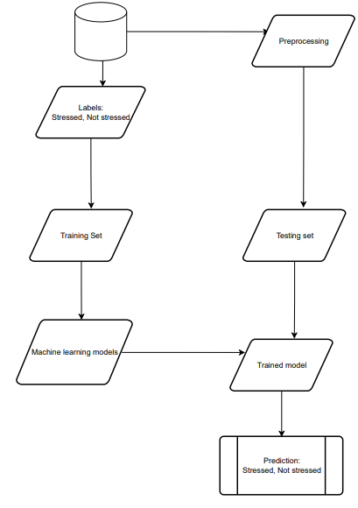
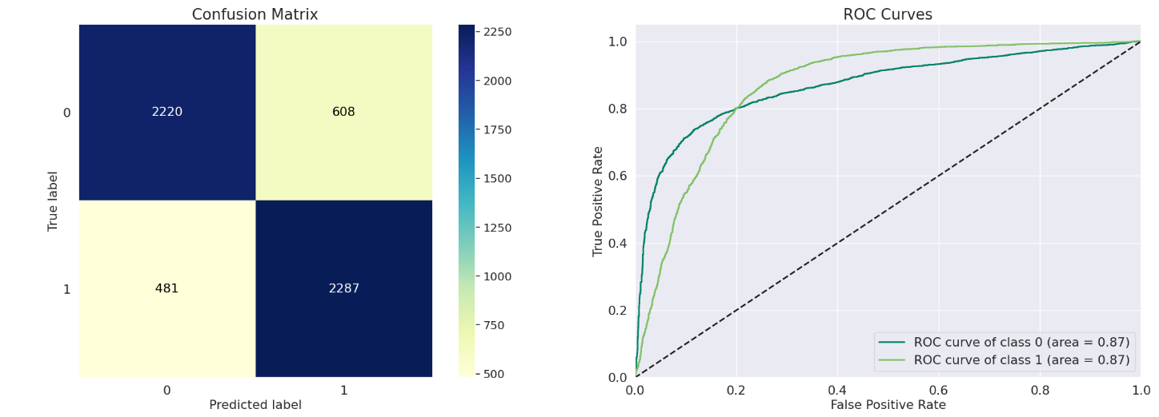
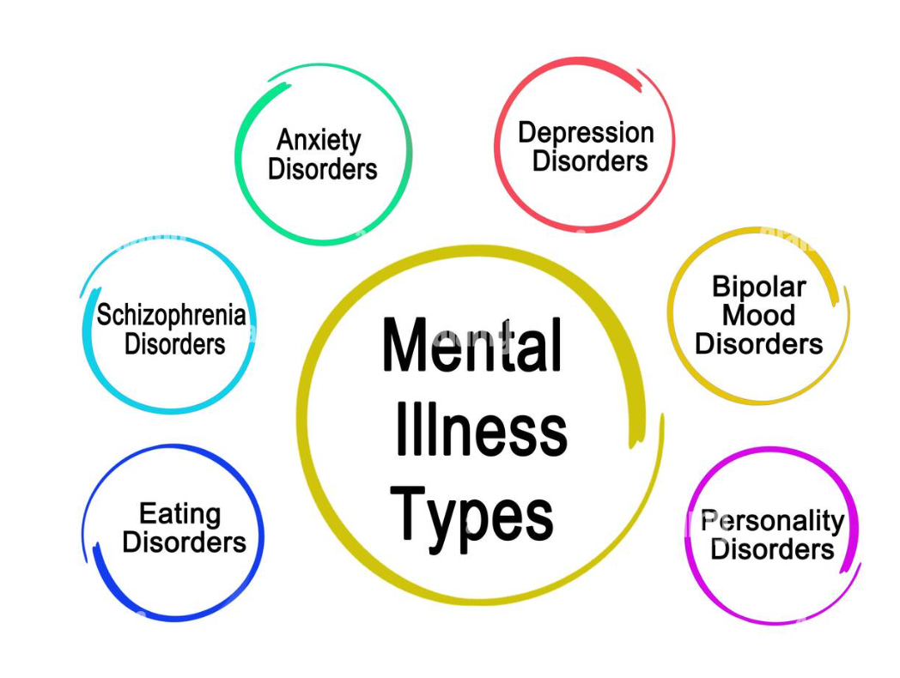
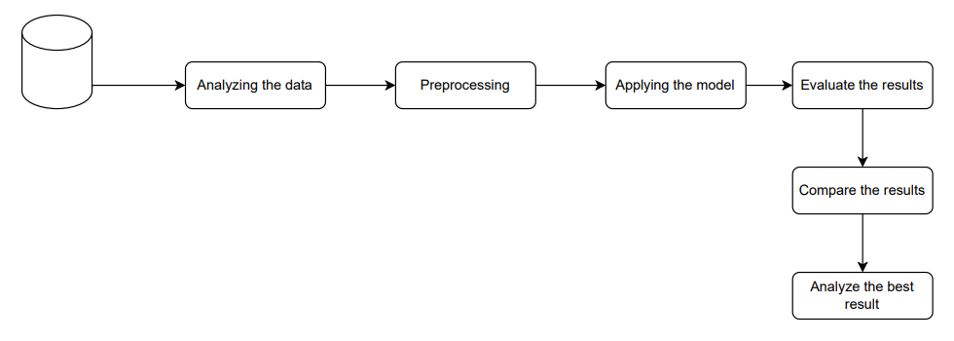
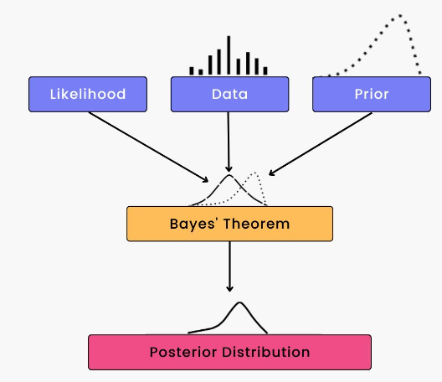
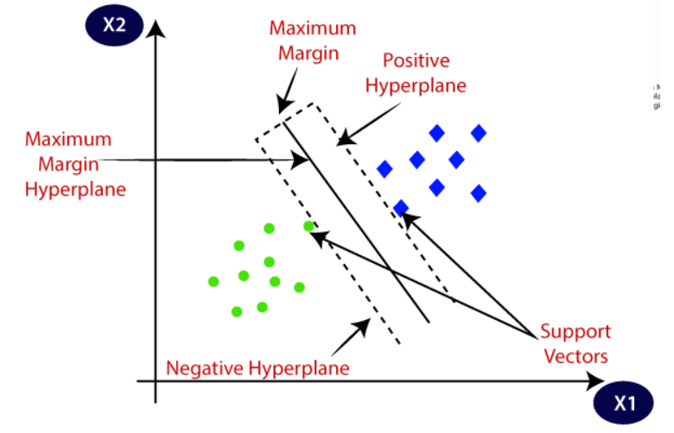
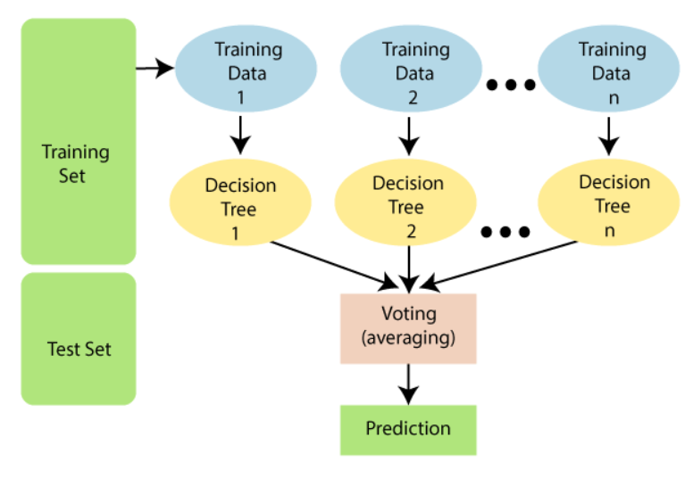
Automated Detection of Mental Disorders from Text using Natural Language Processing By Mariam Yasser Supervisor Dr. Amr Ghoneim
Abstract
System Design/ Interface
Results
Mental illness is prevalent and complex, with various risk factors and associations.
Natural language processing (NLP) can help capture these associations from textual data.
Early detection of mental illness is beneficial for treatment.
Mental health has gained more attention after the pandemic.
Social media is a common platform for people to express their feelings and struggles.
Machine learning can automatically extract valuable features for mental illness detection from text.
Machine learning has seen breakthroughs in various fields including NLP.
Research interest in detecting mental illness from text is growing.
Different data sources and machine learning methods are used in this task.
This project aims to enhance the detection of mental disorders of people by detecting stress which is a main symptom across the majority of the mental illness from text using the mental health data set, different Machine learning models such as Naïve Bayes, Random Forest, LSTM, SVM which are Natural language processing (NLP) methods demonstrate promising improvements to empower proactive mental healthcare and assist early diagnosis. Although, using two feature extraction methods to transforming unstructured text into a structured format suitable for machine learning algorithm which are TF-IDF and Word2vec. Give a narrative review of the approaches, trends, obstacles, and future directions used to detect mental illness using NLP over the last ten years.
The promising results shows by SVM which got the best model upon all the models.
Conclusions
Four machine learning models were used to classify social media posts for signs of stress: Naive Bayes, Random Forest, LSTM, and SVM.
NLP techniques were used to prepare the textual data for machine learning algorithms.
SVM had the highest accuracy in identifying stress in social media posts due to its ability to classify data using linguistic features and patterns.
Automated stress and mental illness identification can provide important information for mental health professionals and researchers.
The study's findings may not apply to other mental health issues and multi-class classification could be explored.
Future studies should examine the generalizability of results and the applicability of models to different types of mental health disorders.
The accuracy and resilience of models may be improved with further development and new data sources.
Social media data analysis can enhance mental health treatment through NLP and machine learning.

